Slide 1

Restaurant Review Classifier: Gauging Customer Satisfaction through Text Analysis
An Automated Sentiment Analysis System for Enhanced Service Quality

Slide 2
Meet the Innovators
Nithya Aishwarya
Poojitha
Pranusha
AP23110010738
AP23110011008
AP23110010335
Sreenidhi
Vennela
AP23110010422
AP23110010058

Slide 3

Identifying the Challenge
Problem Statement: The Manual Maze
Our client, a prominent restaurant chain, faces an overwhelming volume of online customer reviews across various platforms. Manual analysis of this feedback is proving to be incredibly slow, highly inefficient, and prone to human bias. This directly impacts their ability to respond proactively and effectively to customer sentiment.
Our Goal: Automation for Action
An automated classification system is urgently needed to swiftly categorise feedback as either "Liked" or "Not Liked". This will empower the restaurant to gain actionable insights and significantly improve overall service quality and customer satisfaction.
Project Objectives
Natural Language Processing: To proficiently analyse customer reviews utilising advanced Natural Language Processing (NLP) techniques.
Sentiment Classification: To accurately classify review sentiment as positive or negative.
Actionable Insights: To provide clear, data-driven insights that empower the restaurant to enhance the customer experience.

Slide 4






Our Strategic Solution & Workflow
Proposed Solution: Leveraging Machine Learning
Implement robust text preprocessing techniques to clean and normalise review data.
Convert processed text into numerical features using TF-IDF (Term Frequency-Inverse Document Frequency) vectorisation.
Train a supervised Machine Learning classifier to learn patterns between text features and sentiment labels.
Model Training
Review Text
Text Cleaning
TF-IDF
Prediction
This systematic approach ensures efficient and accurate sentiment analysis.

Slide 5


Dataset & Methodological Steps
Our Dataset: Restaurant_Reviews.tsv
Methodology: From Raw Text to Insight
Source: A curated collection of real-world restaurant reviews.
1. Data Import & Libraries
Input Feature: "Review" – The raw textual feedback from customers.
Output Label: "Liked" – A binary indicator (1 for positive, 0 for negative sentiment).
Loading the dataset and essential Python libraries.
2. Preprocessing: NLTK
Stopword removal and stemming to refine text using Natural Language Toolkit (NLTK).
3. TF-IDF Vectorization
Transforming text into numerical vectors, ready for machine learning.
4. Train-Test Split
Dividing data into 80% for training and 20% for testing to ensure model validity.

Slide 6
Core Technologies & Tools
Python
Jupyter / Google Colab
Pandas & NumPy
The foundational programming language for our entire project.
Interactive environments for development, experimentation, and collaboration.
Essential libraries for data manipulation and numerical operations.
NLTK (Natural Language Toolkit)
Scikit-Learn
TF-IDF Vectorizer
Our primary toolkit for machine learning model development and evaluation.
The technique used to convert textual data into numerical features.
Key for advanced text preprocessing, including tokenisation and stemming.
Bernoulli Naive Bayes
The chosen classifier for its efficiency and effectiveness in text classification.
A robust technology stack underpins the accuracy and efficiency of our sentiment classifier.

Slide 7
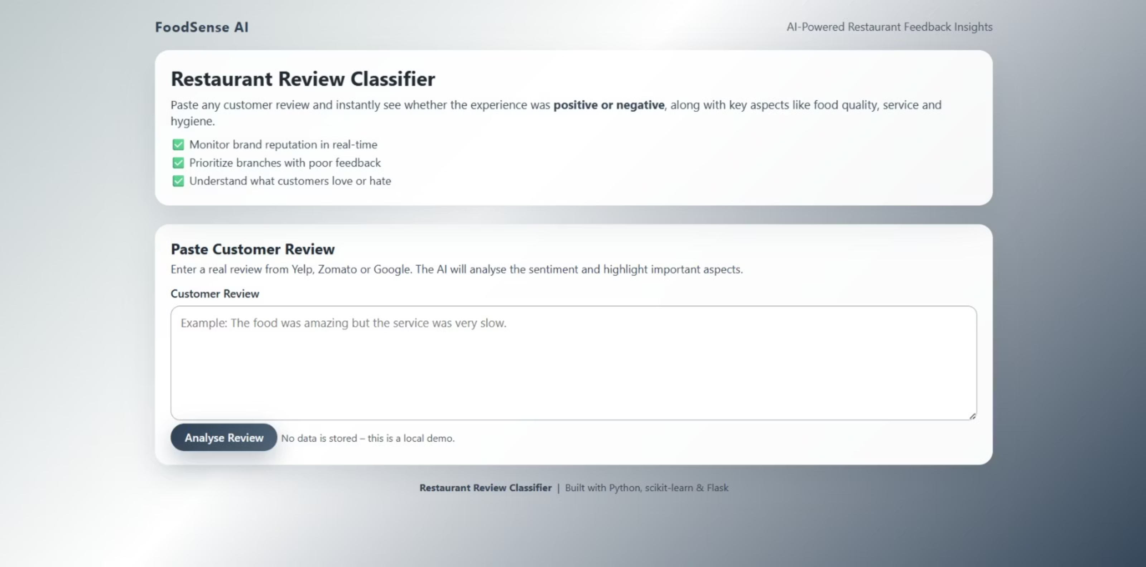
Results & Key Findings
Our project culminates in a user-friendly web interface for the Restaurant Review Sentiment Classifier. This application allows anyone to easily test the model's capabilities in real-time.
Users can paste any restaurant review text into the provided input field and instantly receive a sentiment prediction, indicating whether the review is classified as "Liked" (positive) or "Not Liked" (negative). This demonstrates the practical application of our Bernoulli Naive Bayes model.

Slide 8

Conclusion: Impact & Success
Successful Categorisation
Actionable Insights
The automated classifier successfully categorises restaurant reviews, providing a rapid and reliable method for sentiment analysis.
This system empowers the restaurant brand to quickly identify specific strengths and weaknesses highlighted in customer feedback.
Enhanced Customer Satisfaction
By understanding sentiment at scale, the brand can make informed decisions to significantly enhance overall customer satisfaction and loyalty.
Future Scope
Multi-Class Sentiment Analysis: Expanding beyond binary classification
Support for Emojis & Multilingual Reviews
Mobile/Web Application Deployment
Deep Learning Integration (LSTM/BERT)

